Slide 1

BOTH SIDES NOW: GROWTH THROUGH SHARED LEARNING IN MENTORING RELATIONSHIPS
Kari D. Weaver (She/Her) – Learning, Teaching, and Instructional Design Librarian
Michael Chee (He/Him) – Liaison Librarian for History and Political Science
Stephanie Mutch (She/Her) – Liaison Librarian for Communication Arts, Fine Arts, and Recreation & Leisure
Kate Mercer (She/Her) – Liaison Librarian for Systems Design and Biomedical Engineering

Slide 2

Land Acknowledgement
The presenters respectfully acknowledge that we live, work, and learn on lands of the Haldimand Treaty of 1784, a formally ratified agreement promising the land in perpetuity to the Six Nations of the Grand River and is within the territory traditionally cared for by the Neutral, Anishinaabe, and Haudenosaunee peoples.
This acknowledgement is a small step to challenge colonialism and honour the enduring presence, achievements, and contributions of First Nations, Inuit, and Métis peoples.​

Slide 3
Session Agenda
Introductions
Panelists will be addressing 5 questions about their experiences with mentoring
The conversation will be followed by a Q&A
We will address questions in the order received during the Q&A portion of the session or feel free to reach out to us via email.

Slide 4
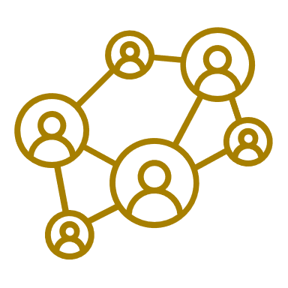

Please introduce yourself and share what sparked your initial interest in mentoring.

Slide 5

Effective mentoring requires investment and coordination from all involved. How do you create and maintain engagement?

Slide 6

Relationships are critical to effective mentoring. How can they be built and nurtured?

Slide 7

Has the mentoring experience impacted your beliefs and/or professional practice?

Slide 8

What is the most important lesson or insight you have learned from your mentoring relationship?

Slide 9


QUESTIONS & ANSWERS

Slide 10

Credits, Licensing, and Contact Information
Panelists:
Kari D. Weaver, kdweaver@uwaterloo.ca
Michael Chee, mchee@uwaterloo.ca
Stephanie Mutch, smutch@uwaterloo.ca
Kate Mercer, kate.mercer@uwaterloo.ca
This presentation is licensed under a Creative Commons 4.0 Attribution- Non-Commercial License (CC 4.0 BY-NC).
Special appreciation: The presenters would like to thank Stef Voichita for the creation of the base design of these slides.
Attribution may be indicated as follows:
Weaver, K. D., Chee, M., Mutch, S., & Mercer, K. (2023, Feb. 2). Both sides now: Growth through shared learning in mentoring relationships [Conference session]. OLA SuperConference, Toronto, Ontario. Link to repository. Used under CC 4.0 BY-NC.
For more information, please email kdweaver@uwaterloo.ca.

