Slide 1
Critical Appraisal and First Year Sciences
Sample slides to accompany:
Weaver, K. D., Mercer, K., & Lamont, G. (2021). “The RADAR framework for evaluating sources of information.” In S. Rowland & L. Kuchel (Eds.) Science + SciComm + Work: A guide for teaching science communication. Springer Nature.

Slide 2
Science Librarians
This presentation is given by the library, as guest lecturers to the course. This slide is where we let students know the name and contact information for their librarians.

Slide 3
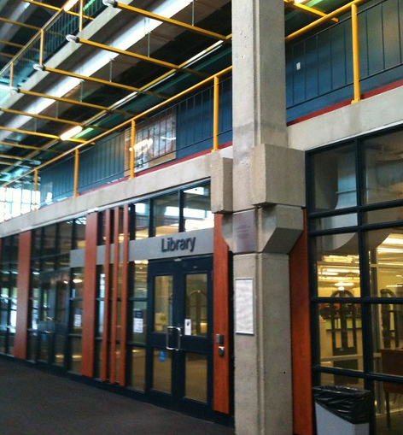

Library Locations
Regardless of who is giving the presentation, it would be helpful to point students to campus resources, like the Library.
Image source: https://uwaterloo.ca/library/about/our-locations

Slide 4
Learning Outcomes
By the end of the course, learners will be able to practice research processes to find, assess, document, incorporate, and cite research resources and communicate research findings.
In practice:
By the end of this exercise, you will be able to locate, critically evaluate, and use scholarly information to facilitate research that inspires and helps you succeed academically and professionally.
Notes:
Speaking Notes:
*Keep it informal*
We’re here to help
You will eventually run into a situation where you need to find something out and the answer isn’t in the textbook, lab manual, or lecture.
Tell them that this class will be a collaboration between you and them – there are no right answers, we want to have a conversation

Slide 5
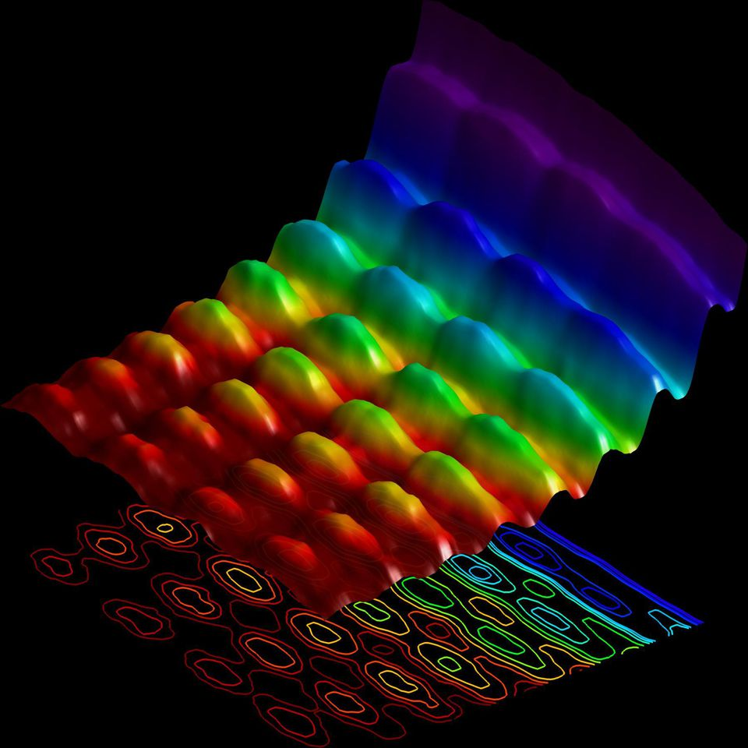
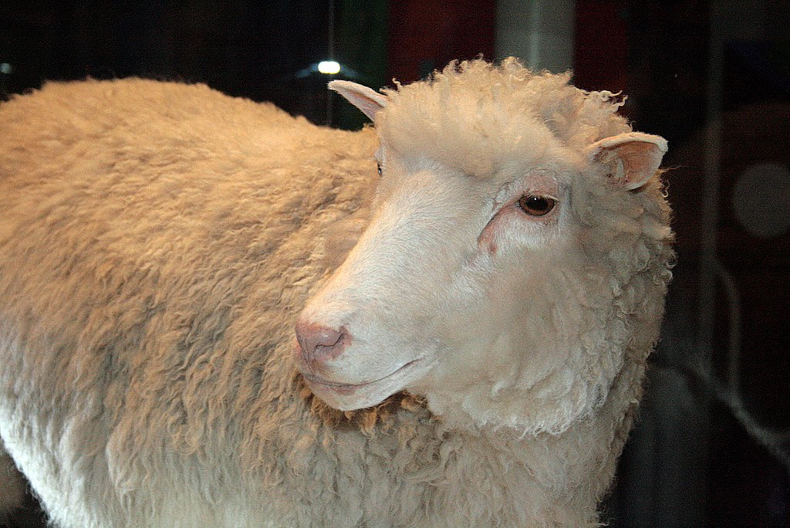
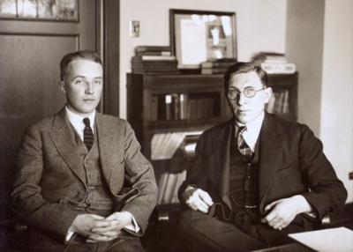

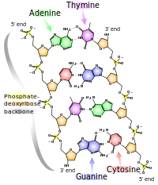
How do you come up with an idea?
Image from Wikimedia Foundation
Image from Wikimedia Foundation
Image above from University of York
Image by Fabrizio Carbone/EPFL
These are some examples – tailor this slide to your students, which area of science they are interested most in/fun topics.
Image from California State University
Notes:
*Speaking notes*
Ask them about the images on the slide – do they know anyone?
Give them hints if they do or don’t
Ask them what they think about coming up with an idea – bring it back to the images, and how each image represents an idea.
For this slide we used:
Drs. Banting and Best, discovered insulin
Dr. George Gray, invented 5CB molecule that led to the development of LCD display screens
Dolly the sheep, first cloned animal
Light as both a particle and a wave
Structure of DNA molecule

Slide 6

The Good, The Bad, The Ugly.
You can see a lot of our slides are deliberately vague – we want students to be talking, not just taking word for word notes.
Why do your teachers hate when you use Google or Wikipedia?
Image source: https://www.vosquestionsdeparents.fr/dossier/738/google-et-wikipedia
Notes:
*Speaking Notes*
This slide is where we ask questions.
A lot of students say things like “You want us to learn and not take shortcuts”.
This is the slide where we tell them it’s ok to Google, and start the discussion on how sometimes it seems like Google is faster, but after you’re wading through pages of results, it can actually be much slower.
It’s also worth playing the thought game of “what’s 20 pages into results? What aren’t you seeing? How does google rank results?”
Talk about why they use and like google, reddit, Wikipedia, whatever they use.
Talk about why it’s ok to start there, but talk about rigor and reliability
A good question for discussion is “Do any of you know how google ranks results?” Talking about how it’s click based rather than quality based is a really good intro to this as a topic

Slide 7












How do you find information?
Notes:
*Speaking Notes*
Tailor this slide to the resources they use at your institution, and specifically they will use for their program (IEEE, ACM, etc)
The idea with this slide is that it’s a spectrum, and that today they may be starting at Google, but as they progress they’ll get more experience working with the range
This is where we take a pause and get them to link Google Scholar to their university email, letting them search our catalogue through Google Scholar

Slide 8
THE PROBLEM
Tailor this slide to your article – we usually leave this up for their discussion to remind them what they’re thinking about
As part of a company wellness campaign, your organization is trying to decide whether or not they should fund a wearable fitness tracker. Your supervisor has asked you to read an article and report back with a position on whether or not wearable fitness trackers were effective workplace interventions.
Notes:
*Speaking Notes*
This is if you choose to use an article. We also run this depending on time and course objectives where they have to search for their own article on a topic of their choosing. For that, we change the text to:
We want you to think about a topic you find interesting, related to your field of study. When you have found an article, think about this article and if it is one you would trust to use for an academic course, what you liked about it, what you didn’t like, and if you find it trustworthy.
Have them look over the document - What is the problem you are trying to solve by doing this task? What information do you need to know/gather?
You need to know whether or not the document is any good. How?
Not all sources are created equally
A good source for one context is a bad source for another
We usually have them break into groups for this section – talking amongst themselves helps emphasize all of this

Slide 9
Thinking critically about a source
For this part of the discussion, we focus in on what is bias? Is it good? We remind them that everyone is biased, and being aware of their bias is important, because it helps them be critical thinkers
What is bias?
What does it take for an article to be published?
What about skepticism in science?
How do you situate yourself in science?
Notes:
*Speaking Notes*
This tends to be the slide where we have the most discussion.
We largely emphasize Bias – what is bias? We talk about if they are biased, we talk about unintentional bias, and if they think it happens in STEM. We go through how important it is to be aware of your bias, but just because you’re biased, doesn’t mean you’re wrong. Usually we bring up some examples that are easy – vaccines do not cause autism, climate change
We then go into a discussion about skepticism, and article publishing, talking about how there are many decisions made before that pdf shows up on your screen
We end with a talk about authority – how many of them are considered experts by people who know less than them? Were they peer tutors? What is their responsibility as learners to base their decisions off good information.
We end with a chat about expertise – how they need to situate themselves with evidence, because learning what is good information will help them become good scientists.

Slide 10
RADAR
Rationale: Why was this information created/published?
Authority: Who is the author? What are their credentials?
Date: When was the information published?
Accuracy: Is the information accurate? Is it cited?
Relevance: Is this resource a good one for your purpose?
Notes:
*Speaking Notes*
We go through the RADAR – again we suggest tailoring it to your needs and course interests.
All of these are important, but we usually highlight relevance. Often students in the first year tend to just try and make whatever they find work – we emphasize that they need to find the right source, not just any source.
Relevance: HOW is the information that you have found relevant to your assignment?
Authority: * WHO is the author? (this may be a person or an organization) * What tells you that they are authoritative? What are their credentials? Is the author well known and respected? Does the author work for a reputable institution, e.g. a university, research center or organization (e.g. NASA)? Does the author have good qualifications and experience? What does the ‘About Us’ button tell you? Is other information available about them (e.g. from Google?) Does the URL of the site give you clues about authority? Look for names of reputable organizations in the URL Look at the endings of the web addresses: -.edu or.ac indicate universities (but be careful because these addresses may also be used by students: % or ~ before a name indicates that the author is a student) -.gov indicates official government sites -.org indicates a non-profit organization * Does knowing the authority of the site help you make a judgment about the ACCURACY of the information? * Even if you have doubts about the authority of the site, does it contain links to other authoritative or helpful sources?
Date: * WHEN was the information published? Is the publication date important to you?
Appearance: * WHAT CLUES can you get from the APPEARANCE of the source? *Does the information look serious and professional? Does it have citations and references? *Is it written in formal, academic language? Or does it look as if it was written by a nonprofessional? *Does it look as if it was published for children? * Or to sell something?
Reason for writing: WHY did the writer publish this? *To produce a balanced, well-researched, professional piece of work to add to the body of knowledge? * Was it written as part of an ongoing debate, to counter an opposing claim? *Or is it for propaganda, and biased? Note: a biased or problematic site may still be useful to you; the key is to recognize its bias or limitations. * Or was it written in order to sell something? *Or is it a spoof site, written for fun?
From: Mandalios J. RADAR: An approach for helping students evaluate Internet sources. Journal of Information Science Vol 39, Issue 4, pp. 470 - 478 First published date: March-08-2013 10.1177/0165551513478889

Slide 11
In Pairs
Using the article provided apply the RADAR framework. Additionally, consider the following?
Where you are likely to find the answers to these questions? Inside or outside the article?
How is the information in the article structured? What clue does the structure give you about the Reason and Relevance?
How could you record or communicate your findings?
Notes:
*Speaking Notes*
If they found their own article, we ask them to do this and see if their opinion on the article changed.
What did they find when they google the author? Was it different than what they expected?
Try and highlight if finding information needed for RADAR was harder than expected (usually it is)

Slide 12
On a cursory glance, what are the strengths and weaknesses of the article your boss chose?
Where could you go to find additional info?
Notes:
*Speaking Notes*
This is all student discussion
We ask students to talk about what they liked and what they didn’t like
Where to find other information
If the process took longer than they expected it to
We usually tie things up here, and end with highlighting that doing this takes practice. We still do a version of this, but we do it so much it comes more naturally and it goes more quickly.

Slide 13
Specialized Resources for Sciences
E-books:
Databases:
Chemical/Physical Properties:
Library Links:
News Sources:
Notes:
*Speaking Notes
We found that giving them links is helpful – we do have students save this just for the links at the end.

Slide 14
Questions

Slide 15
Contact Information
Kate Mercer (kmercer@uwaterloo.ca), Kari Weaver (kdweaver@uwaterloo.ca). University of Waterloo Library. 2021.

