Slide 1




Microplastics Research Data: Evaluating the Current State of Findability and
Accessibility and Recommendations for Improving Data Sharing
Tia Jenkins¹, Bhaleka Persaud¹, Win Cowger², Kathy Szigeti¹, Dominique Roche^{3,4}, Erin Clary⁵, Stephanie Slowinski¹, Benjamin Lei¹, Amila Abeynayaka⁶, Ebenezer S. Nyadjro^{7,8}, Thomas Mae⁹, Leah Thornton Hampton¹⁰, Melanie Bergmann¹¹, Julian Aherne¹², Sherri A. Mason¹³, John Honek¹, Fereidoun Rezanezhad¹, Amy Lusher¹⁴, Andy Booth¹⁵, Rodney Smith¹, Philippe Van Cappellen¹
¹University of Waterloo, Waterloo, ON, Canada
²Moore Institute for Plastic Pollution Research, Long Beach, CA, United States
³Carleton University, Ottawa, ON, Canada
⁴University of Neuchâtel, Neuchâtel, Switzerland
⁵Digital Research Alliance of Canada, Ottawa, ON, Canada
⁶Institute for Global Environment Strategies (IGES), Kamiyamaguchi, Hayama, Kanagawa, Japan
⁷National Oceanic and Atmospheric Administration (NOAA) National Centres for Environmental Information (NCEI), Stennis Space Center, MS, United States
⁸Northern Gulf Institute, Mississippi State University, Stennis Space Center, MS, United State
⁹GRID-Arendal, Arendal, Norway
¹⁰Southern California Coastal Water Research Project (SCCWRP), Costa Mesa, CA, United States
¹¹Alfred-Wegener-Institut Helmholtz-Zentrum für Polar- und Meeresforschung
, Bremerhaven, Germany
¹²Trent University, Peterborough, ON, Canada
¹³Pennsylvania State University, The Behrend College, Erie, PA, United States
¹⁴Norwegian Institute for Water Research, Oslo, Norway
¹⁵ SINTEF Ocean, Trondheim, Norway
AGU Fall Meeting 2022
December 16, 2022

Slide 2
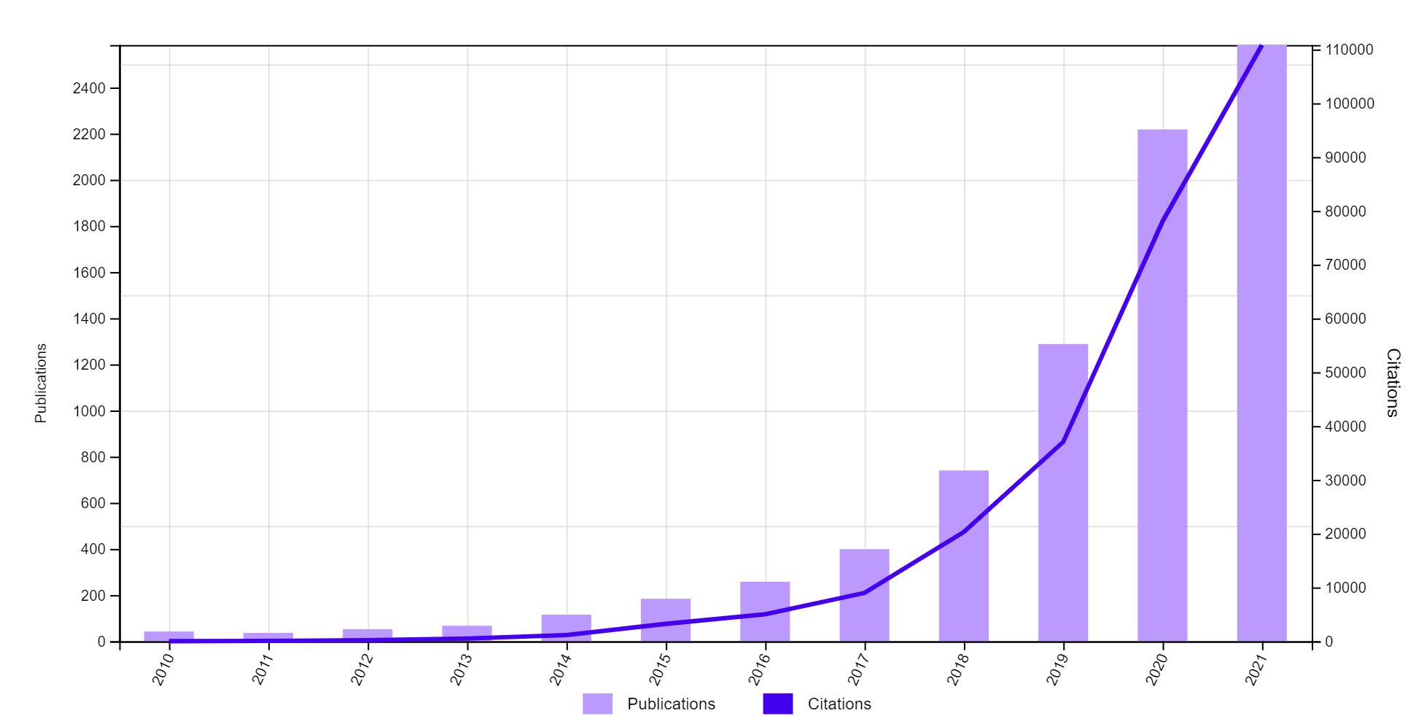
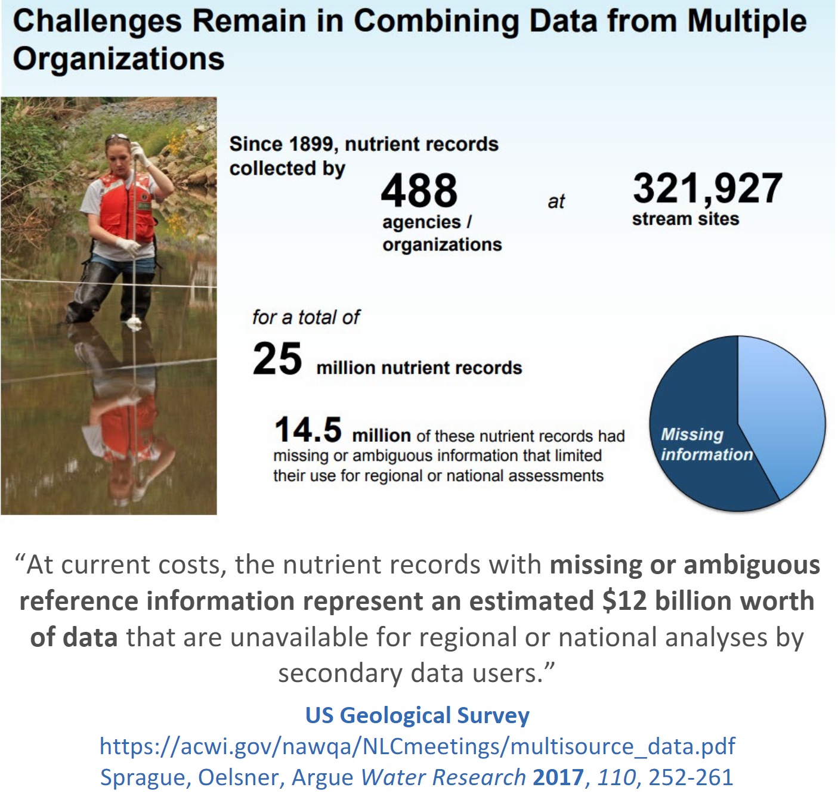
Background & Motivation
Example of the cost of not managing data to be findable, accessible, interoperable, reusable (FAIR):
Increasing trend in microplastics publications since 2010
Environmental microplastics = emerging contaminant & rapidly growing research field
Large amount of research being published
→ Are the data to support the research findable and accessible?
Findable and accessible data are needed to help make informed environmental policy decisions
Notes:
The researches on microplastics have been attracting global concerns. Since more and more data on microplastics are acquired and as policies begin to emerge around the world, it is important that scientists are able to conduct meta-analyses, confirm reproducibility, and meaningfully compare data from different studies.

Slide 3
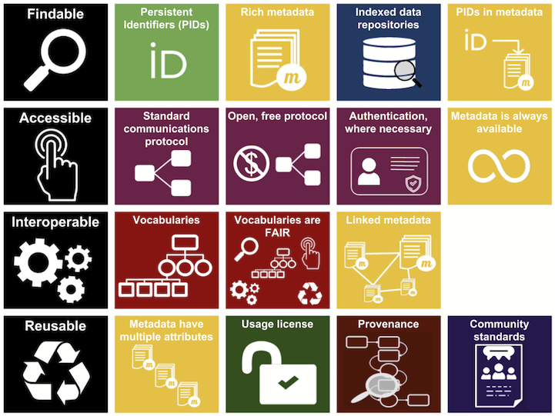
Goal
Inspired by FAIR data principles:
To what extent are the data that underpin environmental microplastics research articles openly shared?
→ Findable?
→ Accessible?
Metadata and data easy to find for both humans and computers
Once user finds required data, need to know how to access
Data need to interoperate with workflows for analysis, storage, and processing
Metadata and data should be well-described so that they can be replicated and/or combined
Notes:
Evaluating findability and accessibility was a first step
FAIR Principles:
support its reuse by individuals.
Standards for data description, interoperability, citation are at the core of these principles.

Slide 4
Methods: Evaluating data sharing in (1) articles and (2) repository datasets
(1) Articles about microplastics
Randomly selected 20% of 6608 peer-reviewed microplastics articles to determine:
  Is a data sharing statement included?
  If yes, how are the data shared?
(2) Microplastics datasets in data repositories
Searched 10 repositories using the term “microplastic*” or “(microplastic OR microplastics) to gather data and metadata attributes
Repository | Acronym used here | Repository type
Dryad | Dryad | General
Environmental Data Initiative Portal | EDI Portal | Environmental and ecological data
Environmental Information Data Centre | EIDC | Datasets related to terrestrial and freshwater sciences
Figshare | Figshare | General
Harvard Dataverse | Harvard DV | General
Mendeley Data | Mendeley | General
Pangaea | Pangaea | Earth System
Polar Data Catalogue | PDC | General focus on Cold and high latitude regions
SEA scieNtific Open data Edition | SEANOE | Marine sciences
Zenodo | Zenodo | General
Notes:
Two strategies were adopted to identify and locate open datasets: (1) we reviewed the data sharing statements in a representative subset of peer-reviewed publications on environmental microplastics, and (2) we undertook a comprehensive search of relevant online data repositories.

Slide 5
Data sharing trends in peer-reviewed articles
2006-2012: only 8 articles included data sharing statements
2013 onwards: data sharing statements start to increase
2019 onwards: half of articles published contain a data availability statement

Slide 6
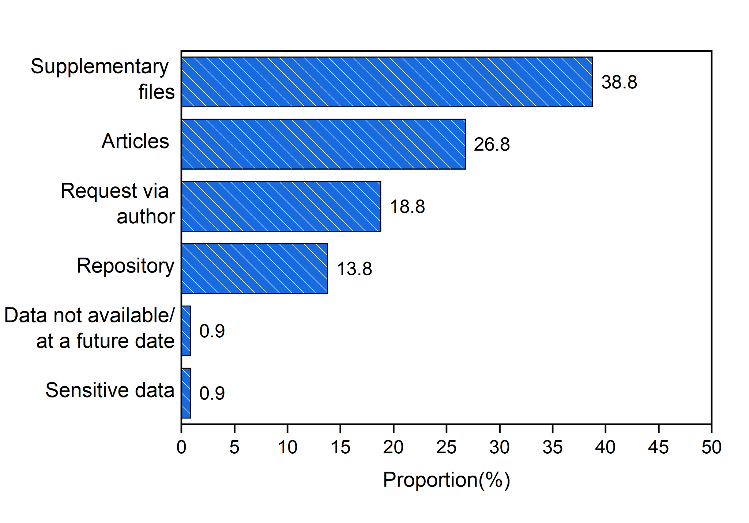
How are data being shared?

Slide 7
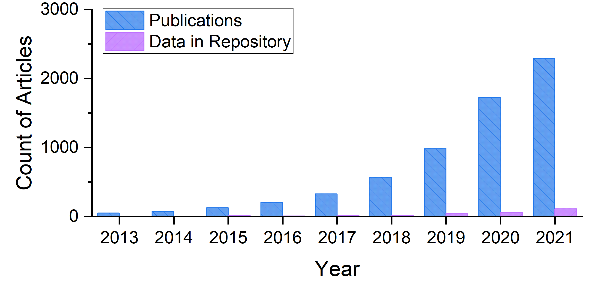
Comparing trends: publications vs. data sharing
Rate of increase in publications not matched by rate of increase in data shared in repositories
Notes:
ike datasets are hardly increasing as a proportion of overall publications. But there is hope here in 2021. There are exponential increases in both open access data and publication microplastics in the last 9 years. However, rate of increase of the open access data do not align available publications

Slide 8
Datasets in repositories: repositories used and file accessibility
Of the datasets studied, 80% (n=222) had data files that were accessible
Remaining 20% (n=57) had data files that were not accessible or further approval was required for access and download

Slide 9
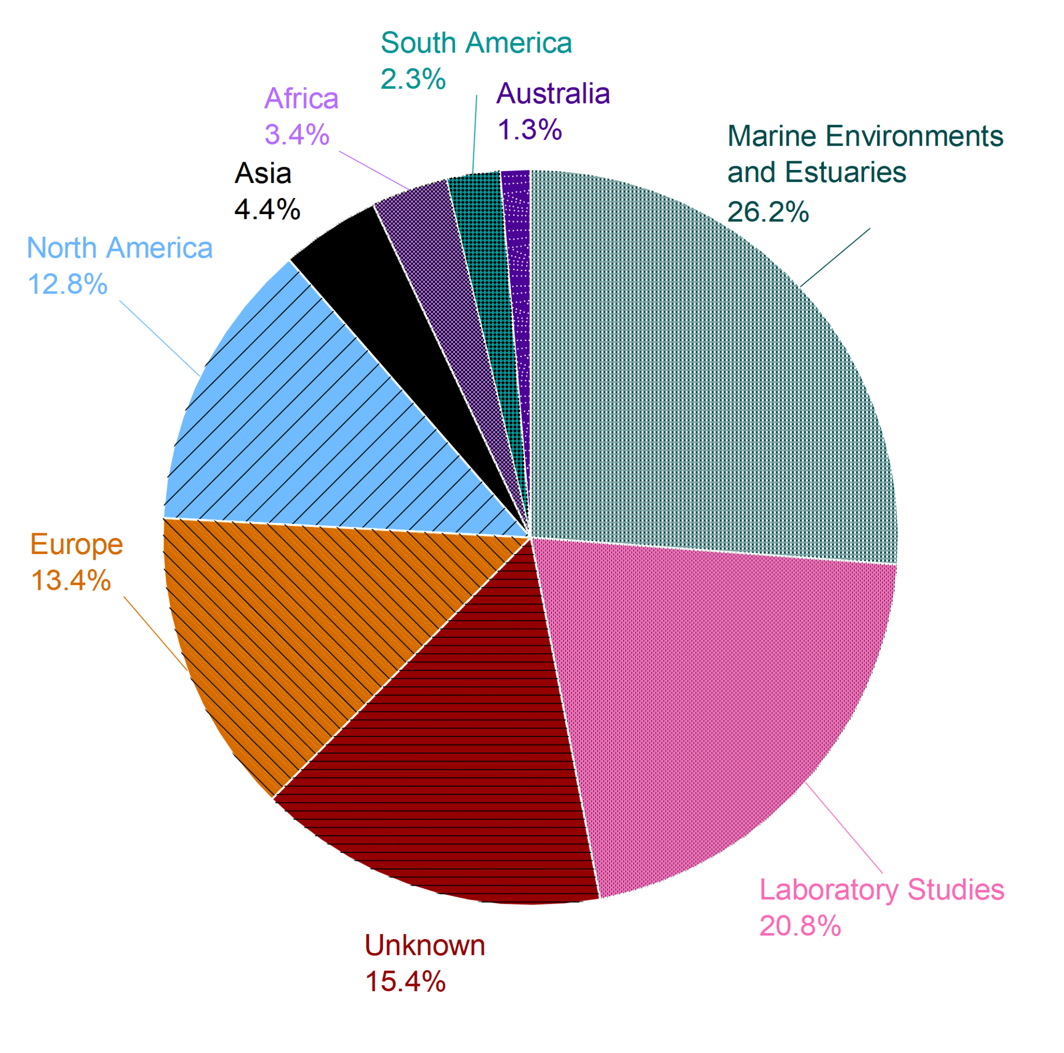
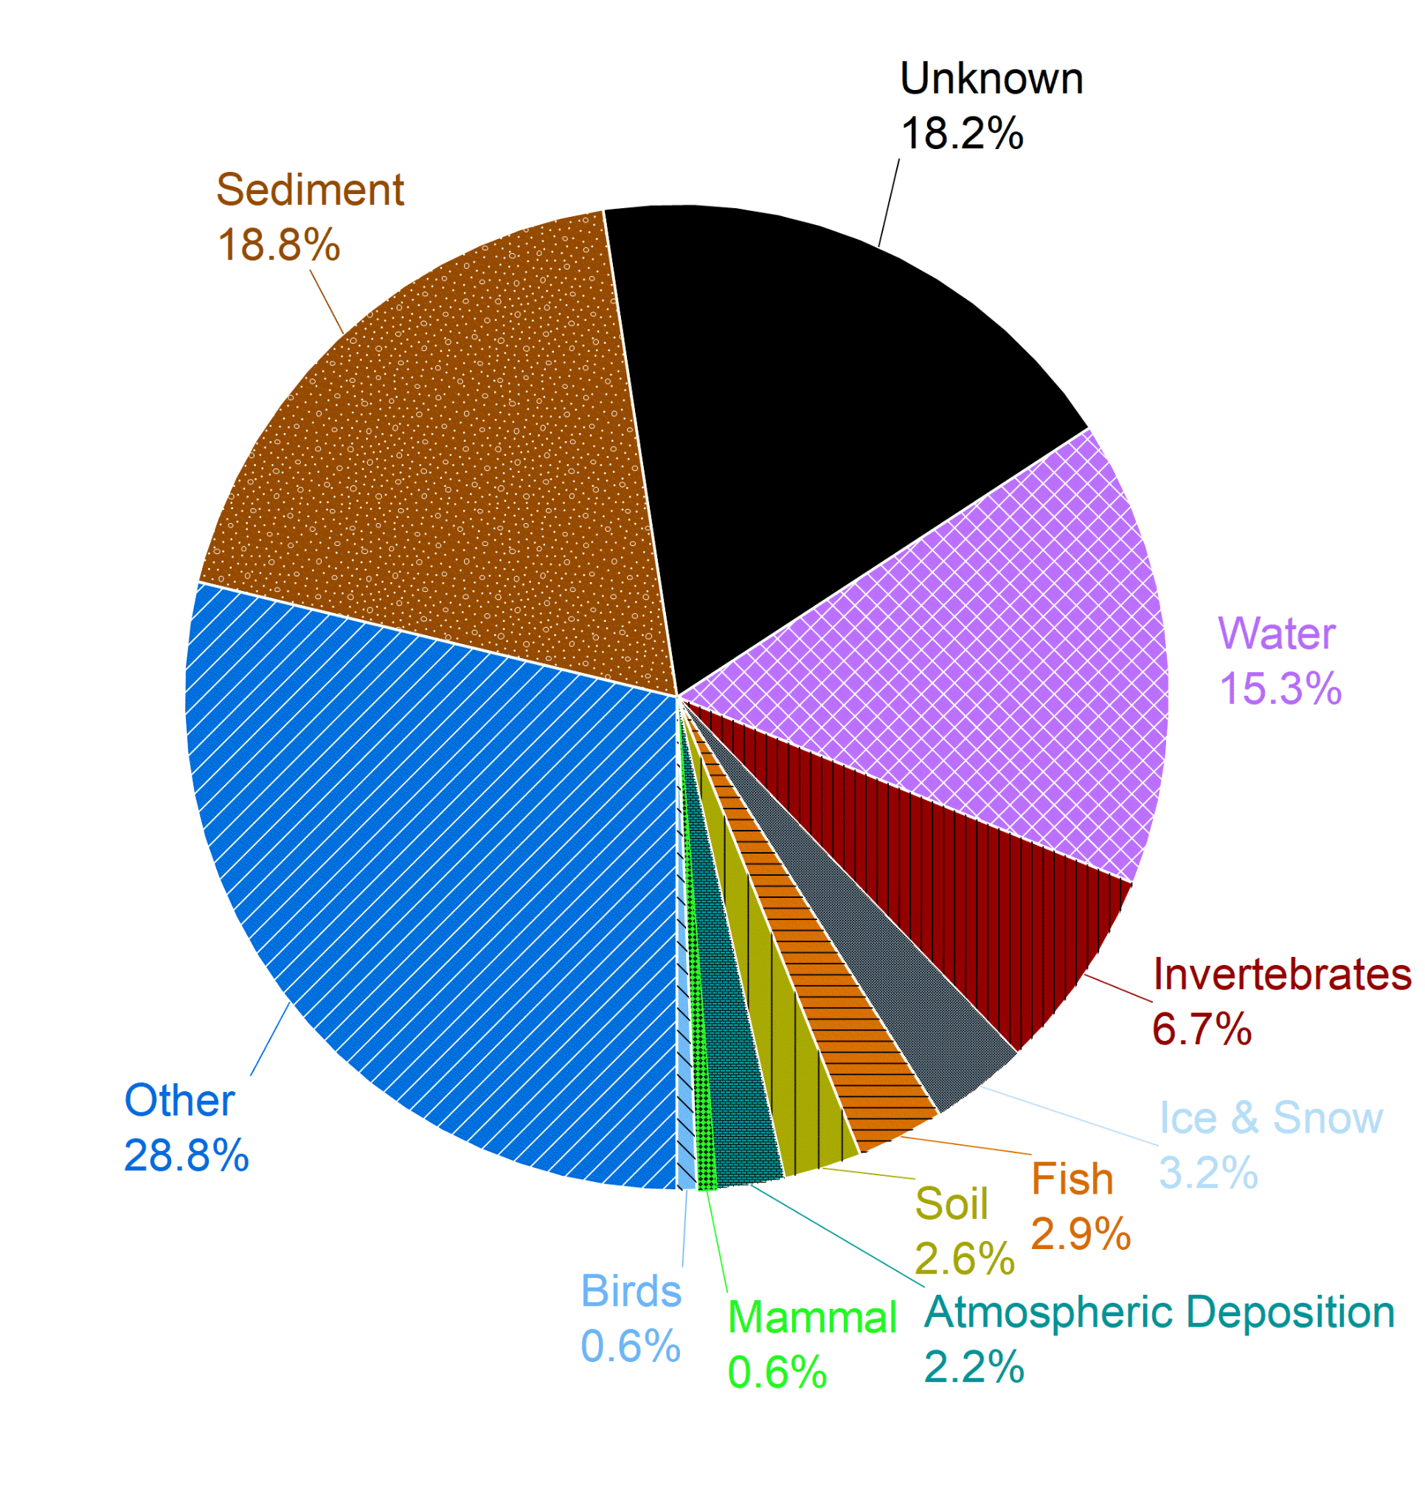
Metadata attributes: Are open data adequately described?
Geographic distribution of microplastic data (Actual places where data were collected)
Distribution of microplastics data by media type

Slide 10
Recommendations
Based on our findings, we offer these recommendations to strengthen data sharing practices in the environmental microplastic research community:
Use available standards to describe (meta)data
Share raw data - or as close to raw as possible
Use a trusted digital repository (which has a data curation process)
Link dataset to publications (using data availability statements and link to persistent DOI)
Plan to share data from the outset of a study
Read more at: https://www.frontiersin.org/articles/10.3389/fenvs.2022.912107/

Slide 11
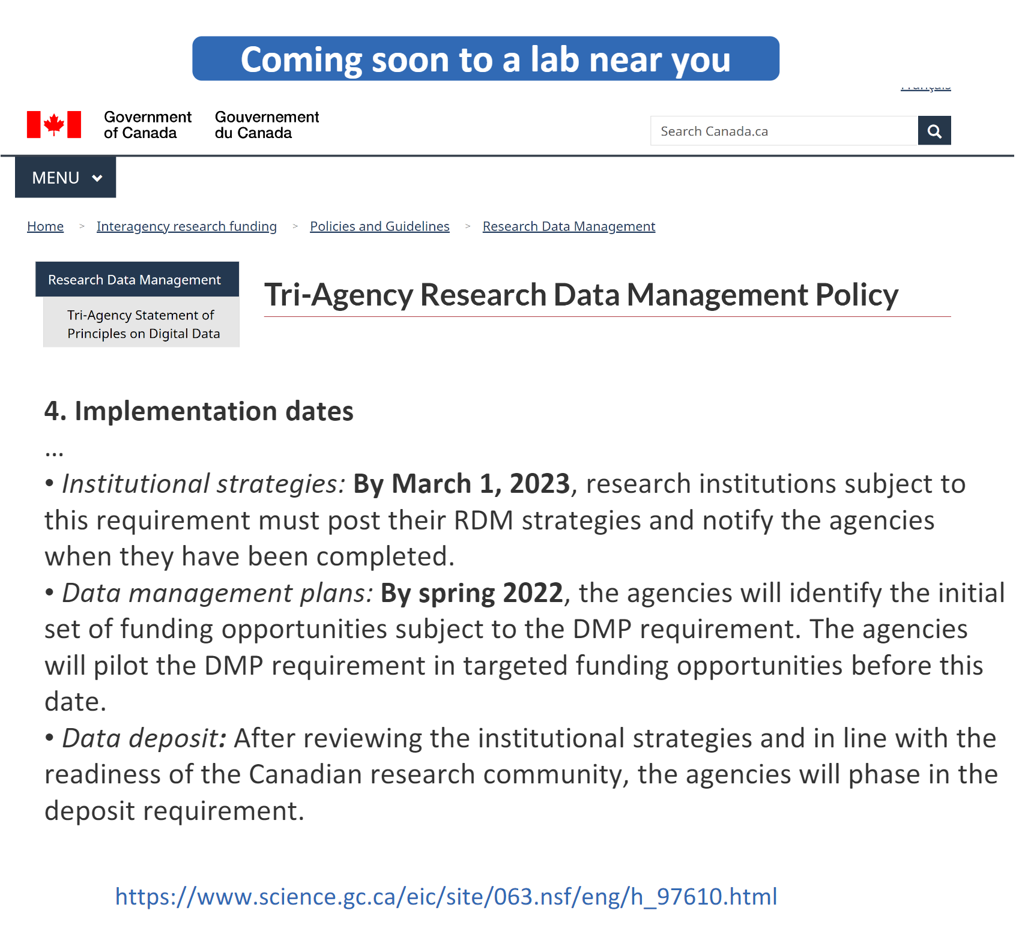
Conclusions
Evidence that data sharing practices are increasing
Some challenges will need to be addressed to ensure the long-term findability and accessibility of data
FAIR data will be vital baseline for future monitoring and decision making
Notes:
While data sharing trends in microplastics are increasing, There are challenges to data management and sharing practices that will need to be addressed to ensure the long-term availability and accessibility of data which can serve as vital baseline data for future monitoring and decision making
The rapid growth in microplastic pollution research is influencing, funding priorities, environmental policy, and public perceptions of risks to water quality and environmental and human health. Ensuring that environmental microplastics research data are findable, accessible, interoperable, and reusable (FAIR) is essential to inform policy and mitigation strategies.

Slide 12
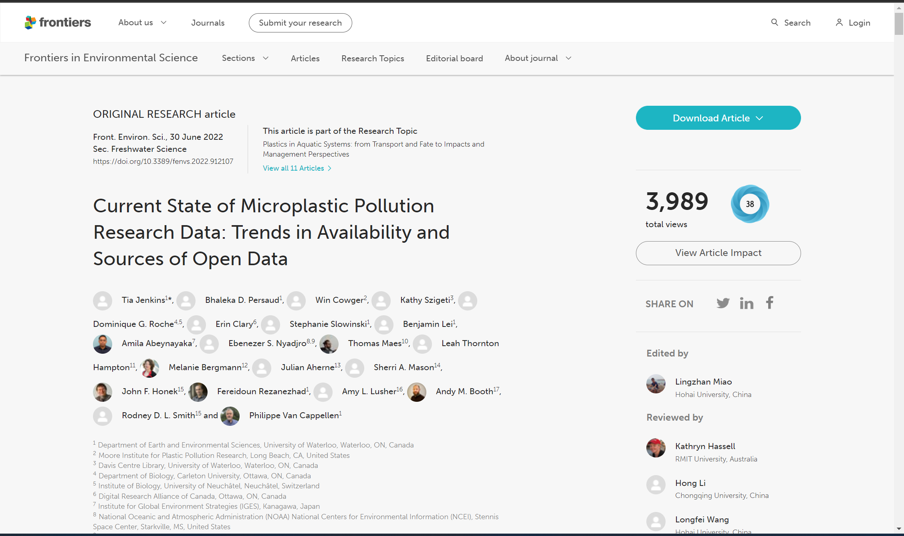
Read more about this work

Slide 13










Acknowledgements
This work was primarily funded by:
NSERC Alliance Grant: Plastics science for a cleaner future (Grant Agreement #: ALLRP 558435-20).
Additional funding support is also acknowledged from the following:
Global Water Futures (Canada First Research Excellence Fund)
The McPike Zima Charitable, the PoF IV program “Changing Earth - Sustaining our Future” Topic 6.4 of the German Helmholtz Association,
Research Council of Norway projects REVEAL ANDROMEDA
MicroLEACH
Early-Career Research Fellowship from the Gulf Research Program of the US National Academies of Sciences, Engineering, and Medicine
European Union’s Horizon 2020 Coordination and Support Action Programme
The Union Horizon 2020 research and innovation program under Marie Skłodowska-Curie grant agreement no. 838237-OPTIMISE.

Slide 14
Data availability statement & Acknowledgments
The datasets generated and analysed in this study can be found in the Federated Research Data Repository at https://doi.org/10.20383/102.0476
Special thank you to Dr. Martin Wagner at the Norwegian University of Science and Technology for his inputs during project conceptualization and on an earlier draft of manuscript and to Ms. Mickey Nielsen at the University of Waterloo for her project coordination support.

