Slide 1
What is #LODLAM?!
Understanding Linked Open Data in Libraries, Archives [and Museums]
Alison Hitchens
OLA Superconference January 29, 2015
Toronto, ON
Revision of a presentation given at OLITA Digital Odyssey, Ryerson University, June 6,2014

Slide 2
Linked [open] data and Resource Description Framework (RDF)

Slide 3
What is linked data?
method of publishing structured data so that it can be interlinked and become more useful
builds upon standard Web technologies such as HTTP, RDF and URIs
rather than using them to serve web pages for human readers, it extends them to share information in a way that can be read automatically by computers
Massaged from Wikipedia linked data page

Slide 4
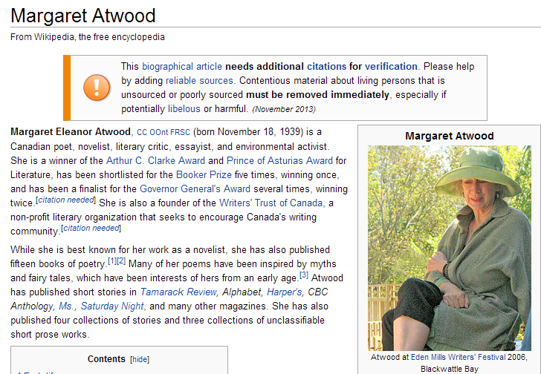
Is your information machine-actionable?
From Wikipedia page for Margaret Atwood

Slide 5
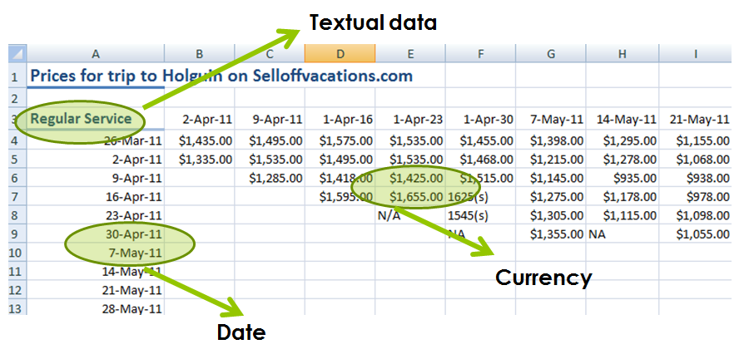
Use structured, machine-actionable data

Slide 6
Identify your data
Type of resource: person
Name: “Margaret Atwood”
Birth date: 19391118
Place of birth: Ottawa, Ontario
Occupation: novelist
Author of: “The Handmaid’s Tale”
See examples from the DBpedia page for Margaret Atwood
Margaret Atwood is a person
Margaret Atwood’s name is Margaret Atwood
Margaret Atwood was born on November 18, 1939
Margaret Atwood was born in Ottawa, Ontario
Margaret Atwood’s occupation is novelist
Margaret Atwood wrote “The Handmaid’s Tale”

Slide 7
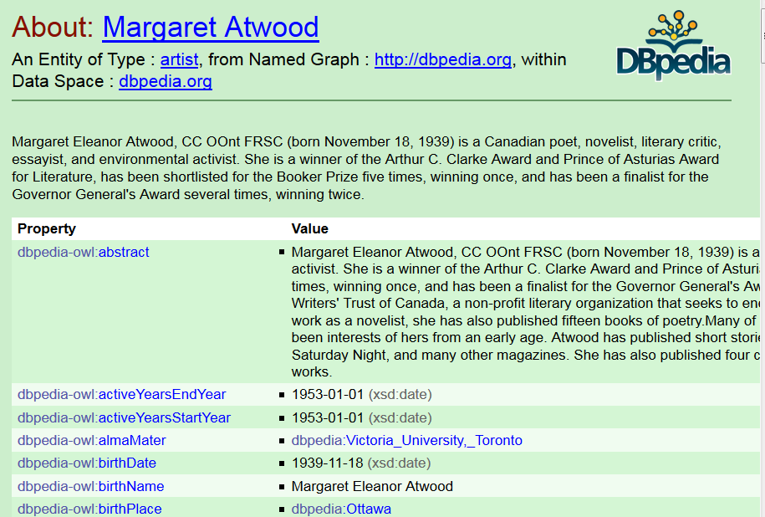
Properties in DBpedia

Slide 8
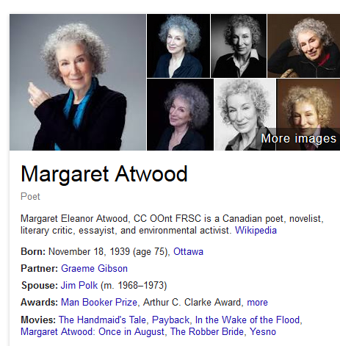
Smarter browser results
Image source: Google knowledge graph based on search Margaret Atwood

Slide 9
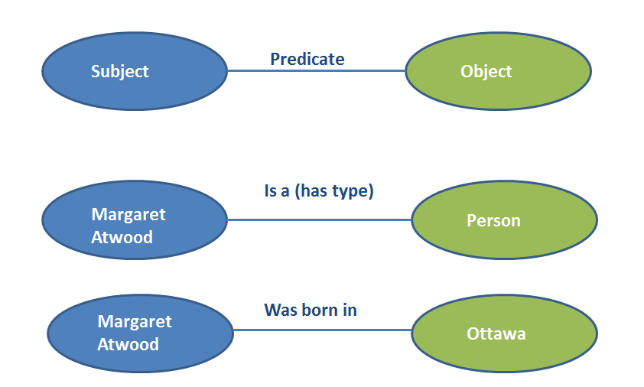
Structure your data using RDF

Slide 10
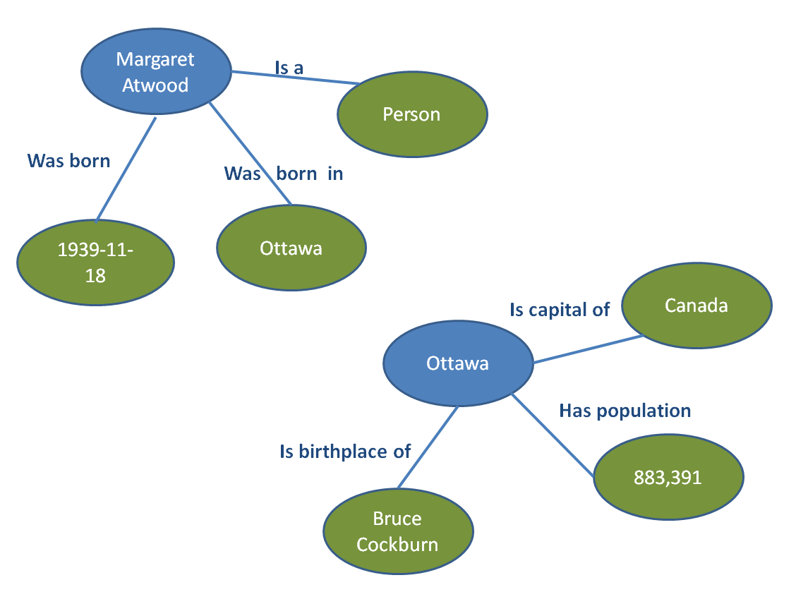
RDF data as a web of data

Slide 11
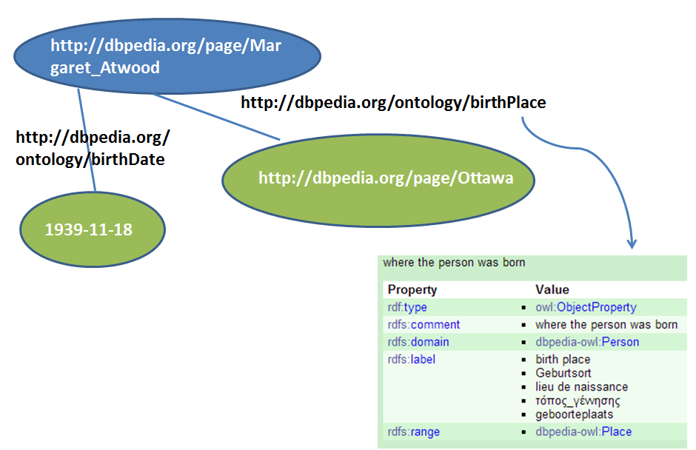
Identify everything with a URI

Slide 12
Re-use vocabularies
Need to define “person”? Friend of a Friend (FOAF) has already done that!
Need to define “subject”? The Dublin Core Metadata Initiative (DCMI) has already done that!
Need to define “genre”? Schema.org has already done that!

Slide 13
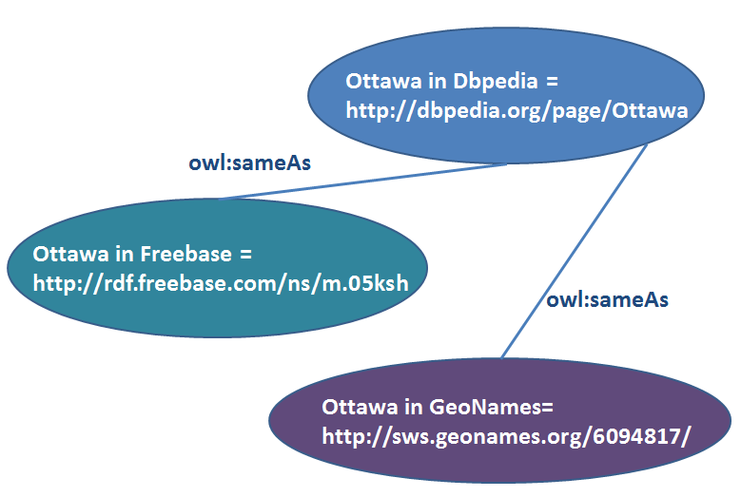
Connect your data

Slide 14
Publish data using standard web formats
@prefix dbpedia: <http://dbpedia.org/resource/> .
@prefix foaf: <http://xmlns.com/foaf/0.1/> .
@prefix ns16: <http://en.wikipedia.org/wiki/> .
ns16:Margaret_Atwood foaf:primaryTopic dbpedia:Margaret_Atwood .
The Wikipedia page Margaret Atwood has as its primary topic the DBpedia resource Margaret Atwood.
From the DBpedia N3/Turtle file

Slide 15
The web of things
person
Alison’s guide to Margaret Atwood
Has subject
Is type of
Margaret Atwood
Has name
“Margaret Atwood”
Undefined URL link to
http://margaretatwood.ca
Has homepage
Inspired by a semantic web slide by Eric Miller

Slide 16
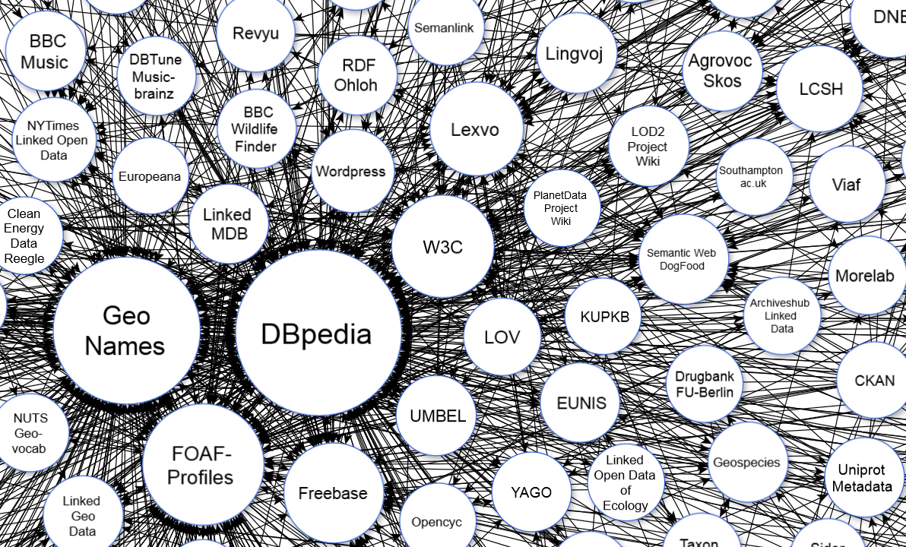
The Linked Open Data Cloud Diagram
Image taken from: "Linking Open Data cloud diagram 2014, by Max Schmachtenberg, Christian Bizer, Anja Jentzsch and Richard Cyganiak.

Slide 17
Linked open data in libraries and archives
Libraries and archives as creators of data
Libraries and archives as consumers of data

Slide 18

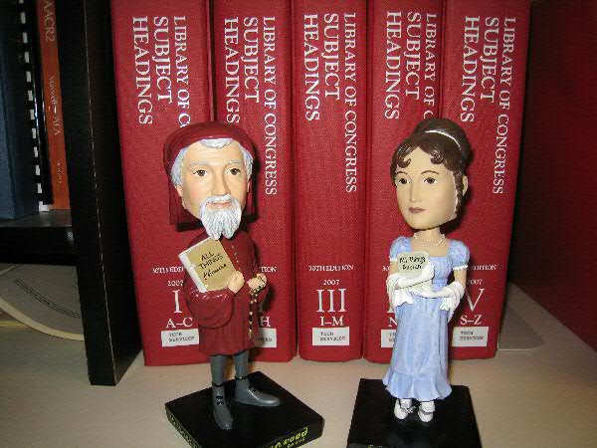
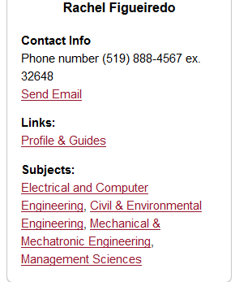
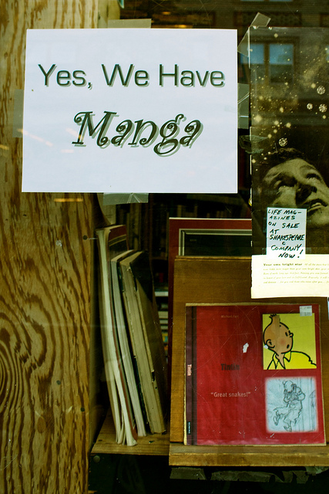
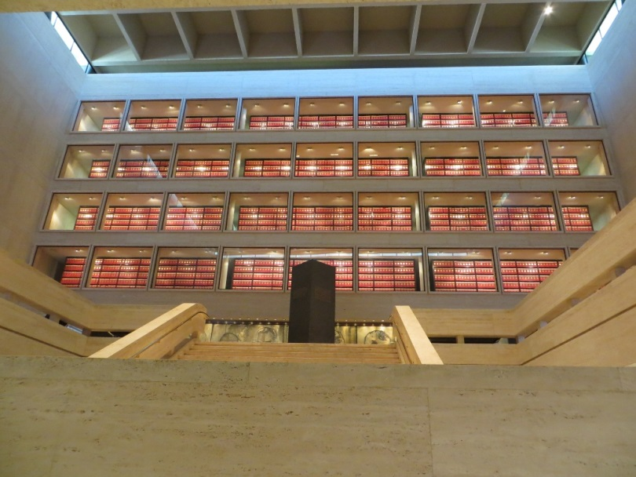
Sharing our data
Notes:
Trust - https://www.flickr.com/photos/criminalintent/3661629219 Lars Ploughman, 2009.
LCSH- https://www.flickr.com/photos/codlibrary/2283643045 C.O.D. Library, 2008
Manga - https://www.flickr.com/photos/klara/4553380171 Klara, 2010

Slide 19
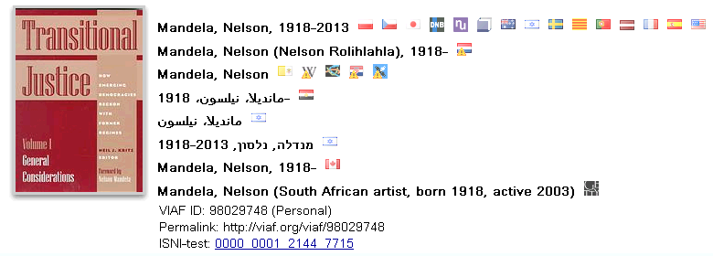
Sharing controlled vocabularies
Virtual International Authority File (VIAF)
Canadian Subject Headings
Library of Congress vocabularies
Art and Architecture Thesaurus (AAT)

Slide 20
Sharing unique resources (via OCLC)
A catalogue of the Lady Aberdeen Library on the History of Women in the University of Waterloo Library
schema: name “A catalogue of the Lady Aberdeen Library on the History of Women in the University of Waterloo Library”
schema: creator http://viaf.org/viaf/265365743
rdf:type schema: Organization
  schema:Name “University of Waterloo. Library. Lady Aberdeen Collection”

Slide 21
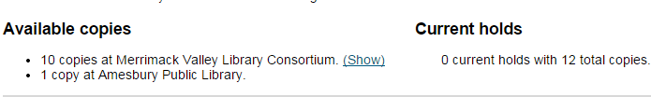
Sharing holdings information
Holdings for “The unofficial Harry Potter cookbook” at Merrimack Valley Library Consortium
property="offers" typeof="Offer“
property="seller" typeof="Library”
<meta property="price" content="0.00">
<span property="sku">j641.59 BUC</span>
<link property="availability" href="http://schema.org/InStock" />Available</>

Slide 22
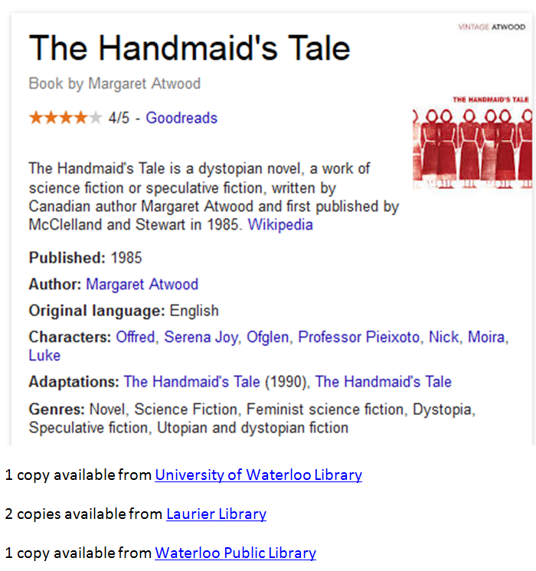
Imagine use of our holdings data
Inspired by a Karen Coyle blog post

Slide 23
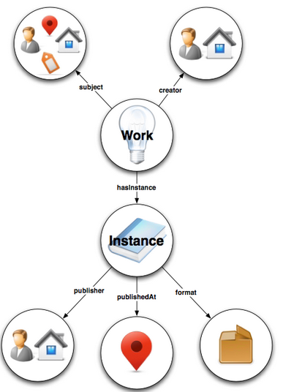
Replacing MARC
bf:BIBFRAME
Creative Work
Instance
Authority
Annotation
Image source: Library of Congress. Overview of the BIBFRAME Model http://www.loc.gov/bibframe/docs/model.html

Slide 24

Exploring BIBFRAME with Libhub
“The Libhub Initiative aims to raise the visibility of Libraries on the Web by actively exploring the promise of BIBFRAME and Linked Data. ”
Libhub logo used with permission. Source: http://www.libhub.org/

Slide 25
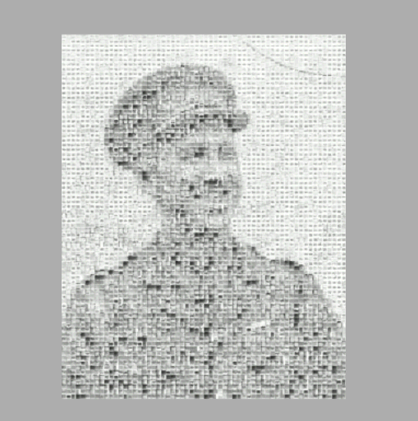
Beyond metadata: sharing our documentary heritage
The Muninn Project
millions of records pertaining to the First World War in archives around the world
extract the written data using massive amount of computing power and turn the resulting information into structured databases

Slide 26
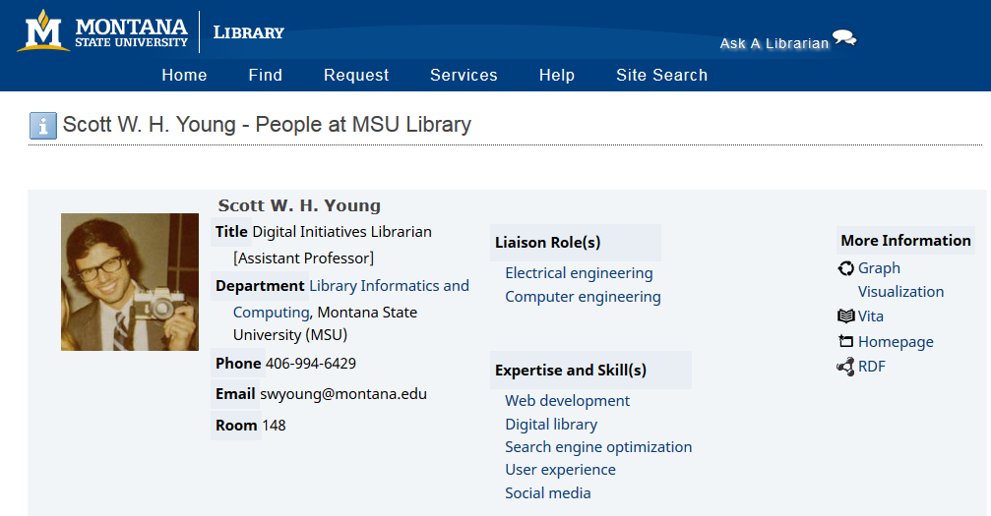
Making library people visible on the web
Source: http://www.lib.montana.edu/people/about.php?id=99

Slide 27
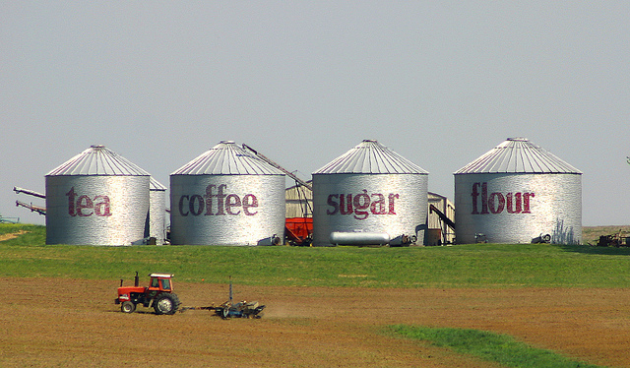
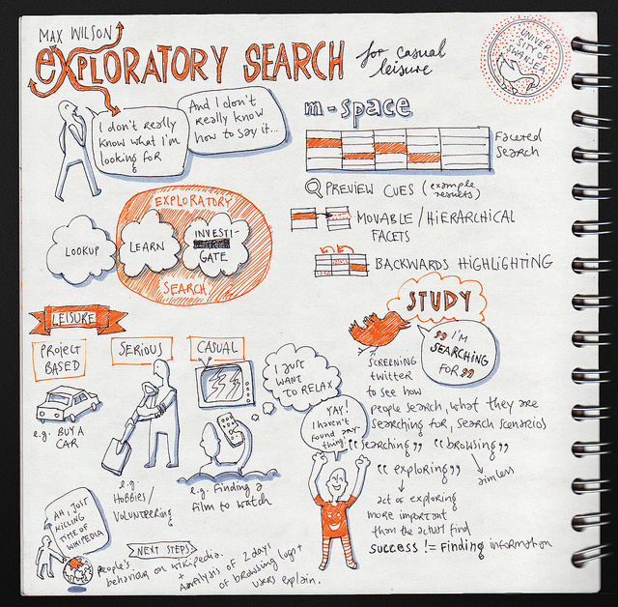

Consuming data to aid discovery

Slide 28
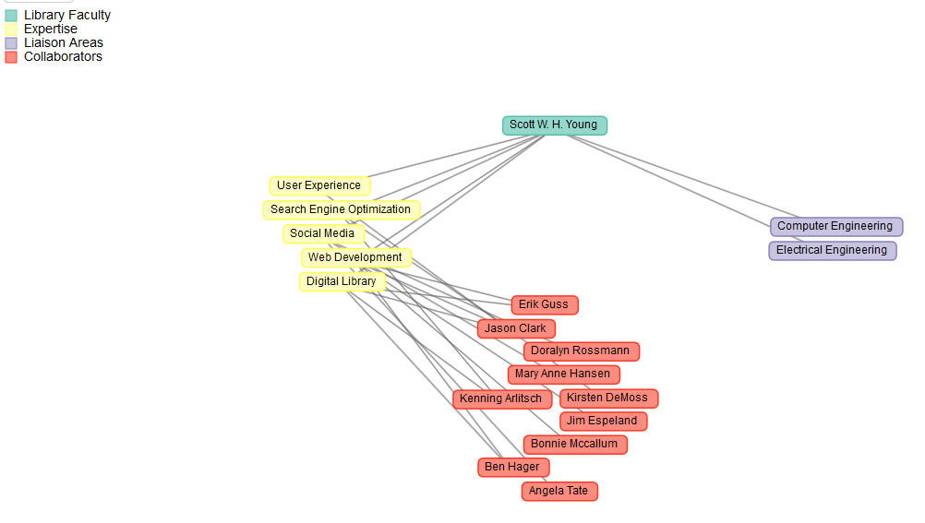
Visualizing library people
Source: http://www.lib.montana.edu/people/network/graph.php?dataset=99

Slide 29
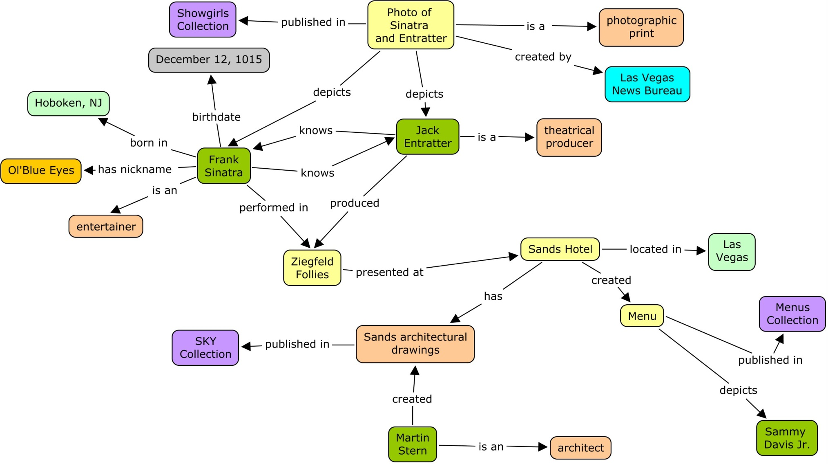
Connecting local digital libraries
Slide from: Unleashing Expressivity / Cory Lampert. Used with permission.

Slide 30
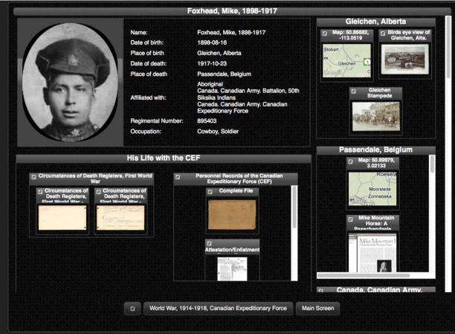
Connecting across libraries & archives
Source: Pan-Canadian Documentary Heritage Network Linked Open Data Visualization “Proof-of-Concept” Out of the trenches: linked open data of the first world war: final report. Image from p. 11

Slide 31
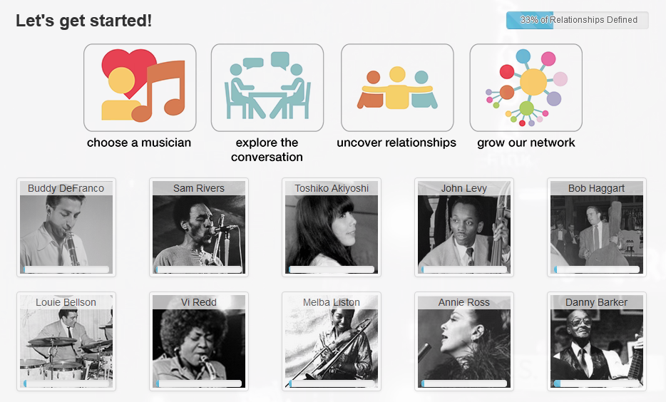
Crowdsourcing Relationships
Linked Jazz 52nd Street https://linkedjazz.org/52ndStreet/

Slide 32
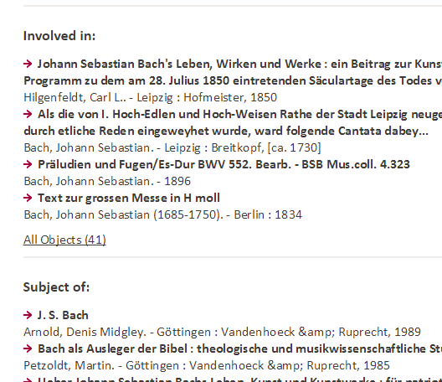
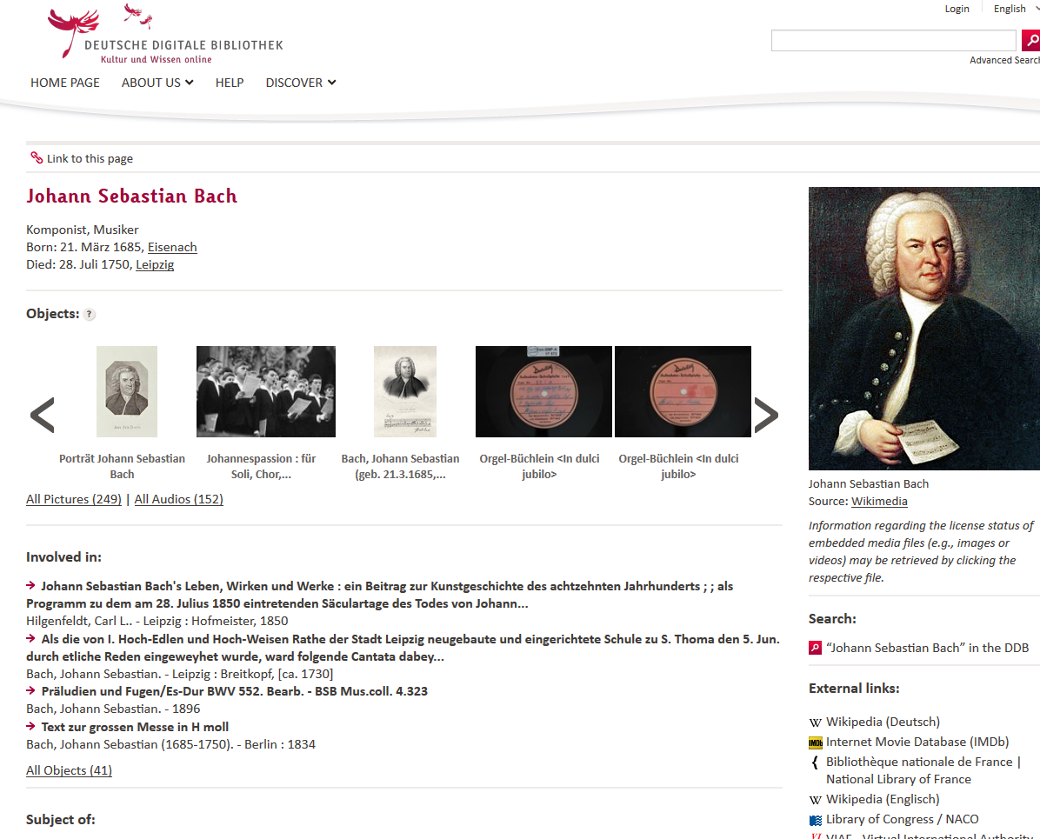
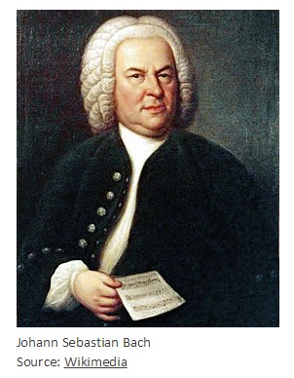
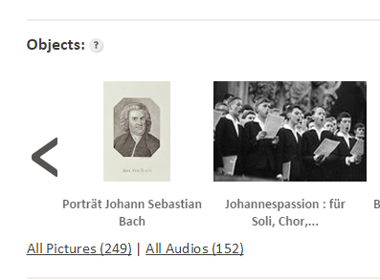
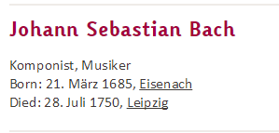
Augment our catalogues
People page option when you search for Johann Sebastian Bach in the Deutsche Digitale Bibliothek

Slide 33
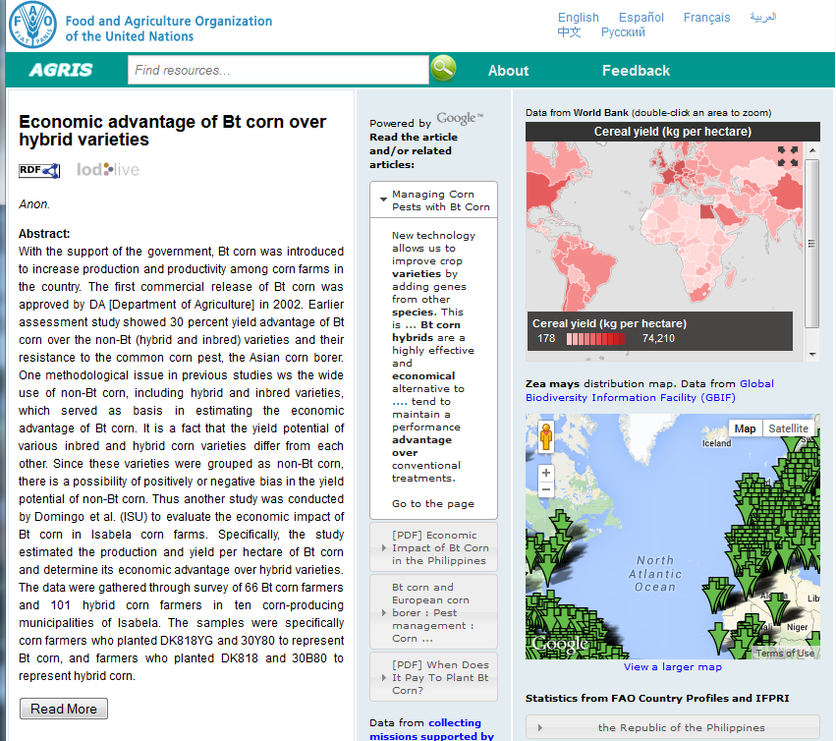
Mash-up external resources: FAO

Slide 34
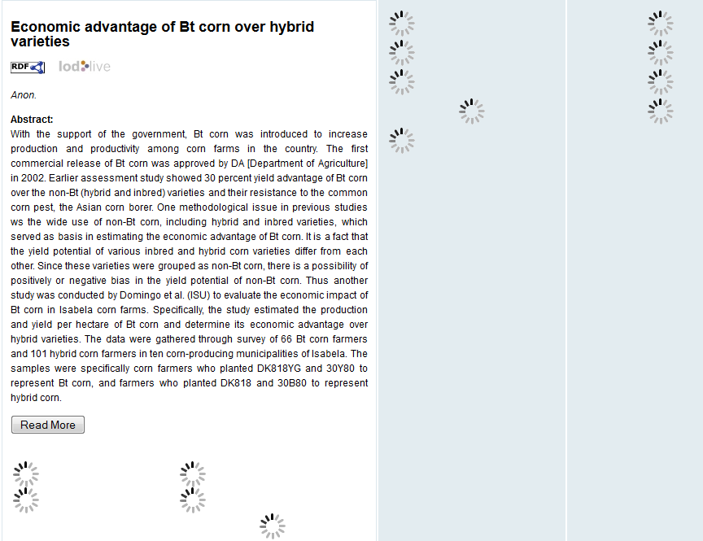
Gathering Data for the Catalogue

Slide 35
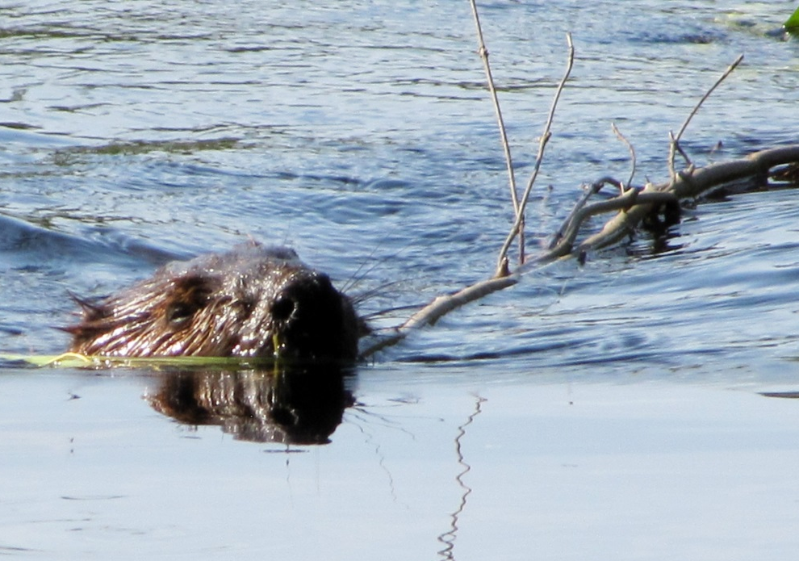
Current state of LODLAM
Developing use cases
Structuring, cleaning and releasing data
Developing new frameworks and tools
Exploration, prototypes and proofs of concept
Learning!

Slide 36
Thank you!
Alison Hitchens
Cataloguing & Metadata Librarian
University of Waterloo Library
E-mail (ahitchen@uwaterloo.ca)
Twitter: @ahitchens
Slideshare (aehitchens)
This work is licensed under a Creative Commons Attribution-ShareAlike 4.0 International License.

Slide 37
Image credits for slide 16
Trust - https://www.flickr.com/photos/criminalintent/3661629219 Lars Ploughman, 2009.
LCSH- https://www.flickr.com/photos/codlibrary/2283643045 C.O.D. Library, 2008
Manga - https://www.flickr.com/photos/klara/4553380171 Klara, 2010

Slide 38
Image credits for slide 23
Silo canister - https://www.flickr.com/photos/14617207@N00/4872111479 Alan Berning 2010
Max Wilson: Exploratory Search @ London Enterprise Search Meetup https://www.flickr.com/photos/evalottchen/5232656622 Eva-Lotta Lamm 2010
Astrolobe, 18th Century - https://www.flickr.com/photos/austinevan/3316195479 Evan Bench 2009

Slide 39
General Linked Data Resources
Tim Berners-Lee (2009) The next web. A TED talk, February 2009. access at http://www.ted.com/talks/tim_berners_lee_on_the_next_web.html (open access)
Karen Coyle (2012). “Is linked data the answer?” Coyle’s Information Thurs. Oct. 18, 2012. http://kcoyle.blogspot.ca/2012/10/is-linked-data-answer.html (open access)
Karen Coyle (2010). Understanding the semantic web: bibliographic data and metadata. Chicago: American Library Association (Library Technology reports ; v. 46, no. 1) http://www.metapress.com.proxy.lib.uwaterloo.ca/content/g212v1783607/ (subscription required)
Tom Heath and Christian Bizer (2011) Linked Data: Evolving the Web into a Global Data Space (1st edition). Synthesis Lectures on the Semantic Web: Theory and Technology, 1:1, 1-136. Morgan & Claypool. http://linkeddatabook.com/editions/1.0/ (open access)
Linked Data: Connect Distributed Data Across the Web http://linkeddata.org/
(open access) (includes the LOD Cloud diagram)
W3C Working Group (2014). RDF 1.1 Primer. http://www.w3.org/TR/rdf11-primer/ (open access)
Notes:
Add for the new slides added

Slide 40
Some LODLAM Projects
Sean Aery (2014) Schema.org and Google for Local Discovery: Some Key Takeaways. Blog post 2014-03-27 http://blogs.library.duke.edu/bitstreams/2014/03/27/schema-org-and-google-for-local-discovery-some-key-takeaways/ (open access)
Jennifer Bowen, Philip E Schreur (2012). Linked Data for Libraries: Why should we care? Where should we start? CNI, April 2-3 2012 Baltimore, Maryland http://www.cni.org/topics/information-access-retrieval/linked-data-for-libraries/ (open access video)
Case Study: King’s College London Boosts Access to its Archives with Linked Open Data (2014) http://www.theeuropeanlibrary.org/tel4/newsitem/5700 (open access)
Jason Clark and Scott W.H. Young. Linked Data is People: using linked data to reshape the library staff directory. Presented at ACCESS 2014, Calgary, Alberta
http://slides.com/swyoung/access-2014-linked-data-is-people/embed?style=light (open access)
James Cuno. Art & Architecture Thesaurus Now Available as Linked Open Data. Blog post 2014/02/14 http://blogs.getty.edu/iris/art-architecture-thesaurus-now-available-as-linked-open-data/ (open access)

Slide 41
Some LODLAM Projects
Food and Agriculture Organization of the United Nations (2014). AGRIS 2.0 http://aims.fao.org/openagris (open access)
Mark Jordan. easyLOD https://github.com/mjordan/easyLOD (open access software)
IGeLU/ELUNA Special Interest Working Group on Linked Open Data http://igelu.org/special-interests/lod (partially open access)
Lukas Koster (2013). “The Poor Person’s Linked Open Data Workbench: Using Discovery Tools for Presenting Integrated Information” in Commonplace.net Nov. 11, 2013 http://commonplace.net/2013/11/the-poor-persons-linked-open-data-workbench/ (open access)
Ulrike Krabo (2011). Exploiting DBPedia for use in Primo. Presentation at IGeLU 2011 Haifa http://igelu.org/wp-content/uploads/2011/09/igelu11_dbpedia_integration_in_primo-Krabo.pdf (open access)

Slide 42
Some more LODLAM projects
LiAM: Linked Archival Metadata http://sites.tufts.edu/liam/2013/09/03/what-is-ld/ (open access)
Libhub http://www.libhub.org/ (open access)
Library and Archives Canada (2012). Canadian Subject Headings in SKOS/RDF Format http://www.bac-lac.gc.ca/eng/news/Pages/canadian-subject-headings-skos-rdf-format.aspx (open access)
Library of Congress. Bibliographic Framework Initiative http://www.loc.gov/bibframe/ (open access)
Library of Congress. LC Linked Data Service: Authorities and Vocabularies http://id.loc.gov/ (open access)

Slide 43
Even more LODLAM projects
Linked Data for Libraries (LD4L) wiki (project of Cornell, Harvard, Stanford) (2014) https://wiki.duraspace.org/pages/viewpage.action?pageId=41354028 (open access)
Linked Jazz http://vimeo.com/68308675 (open access video)
Meaningful Concept Displays http://mcd.ischool.drexel.edu/ (open access)
Erik T. Mitchell (2013). “Library Linked Data: Research and Adoption. Chicago: American Library Association. (Library Technology Reports v. 49, no. 5) http://www.metapress.com/content/rn608wp1077n/ (subscription required)
H.L. Moulaison and S. N. Stanley (2013). “Beyond Failure: Potentially Mitigating Failed Author Searches in the Online Library Catalog Trough the Use of Linked Data” Journal of Web Librarianship (v. 7, no. 1) p. 37-57. http://resolver.scholarsportal.info/resolve/19322909/v07i0001/37_bfpmfattuold.xml (subscription required)

Slide 44
Even more LODLAM projects
The Muninn Project http://blog.muninn-project.org/node/3 (open access)
Peter Neish (2014). Linked Data: Thinking Big, Starting Small. VALA 2014 Proceedings. http://peter.neish.net/wp-content/uploads/sites/6/2014/02/VALA2014-Session-10-Neish-Paper.pdf (open access)
OCLC (2013). Linked Data at OCLC http://www.oclc.org/data.en.html (open access)
Pan-Canadian Documentary Heritage Network Linked Open Data Visualization “Proof-of-Concept” Out of the trenches: linked open data of the first world war: final report. http://www.canadiana.ca/sites/pub.canadiana.ca/files/PCDHN%20Proof-of-concept_Final-Report-ENG_0.pdf (open access)
Stefanie Rűhle, Francesca Schulze & Michael Bűchner. Applying a Linked Data Compliant Model: The Usage of the Europeana Data Model by the Deutsche Digitale Bibliothek. Presented at International Conference on Dublin Core and Metadata Applications DC-2014, Austin, Texas, October 2014
http://dcevents.dublincore.org/IntConf/dc-2014/paper/view/231 (open access)

Slide 45
And even more LODLAM projects
Dan Scott. schema.org: machine-readable cataloguing for the open web. Presented at SWIB14, Bonn, Germany, December 2014 http://www.scivee.tv/node/63282 (open access video)
UNLV’s Linked Data Project (2014) http://www.library.unlv.edu/linked-data (open access)
VIAF: Virtual International Authority File http://viaf.org/ (open access)
Richard Wallis (2013). Linked Data Progress with OCLC and Others. At OCLC Linked Data Round Table, IFLA Conference, Aug. 19, 2013, Singapore. http://www.slideshare.net/rjw/linked-data-progress-ifla-2013 (open access)
Neil Wilson (2014) The Linked Open British National Bibliography http://data.gov.uk/blog/linked-open-british-national-bibliography blog post 22/04/2014 (open access)

